Slide 1
Abstractions for Proving Isolation in Stateful Networks
Mooly Sagiv
Vmware Research Group and Tel Aviv University

Slide 2




Collaborators
Kalev Alpernas
Roman Manevich
Yaron Velner
Aurojit Panda
Sharon Shoham
Scott Shenker

Slide 3
The Network Isolation Problem
Alice
Bob
Given a network…
… and an isolation property
E.g. no packets from Simon to Bob
Is there a run of the network that violates the isolation property?
Switch
Switch
Sam
Simon

Slide 4
The Network Isolation Problem
Alice
Bob
Given a stateful network…
… and an isolation property
E.g. no packets from Simon to Bob
Is there a run of the network that violates the isolation property?
Switch
Cache
Switch
Sam
Simon

Slide 5
Why bother?
States are crucial
Modularity
Security
Performance
Incorrect state manipulations are common source of severe network errors

Slide 6




Security & Performance
Alice
Bob
Firewall
Load
Balancer
Cache
Mallory
Trent
Security (firewalls, IDSs,…)
Performance (caches, load balancers,…)
New functionality (proxies,…)
Notes:
Networks don’t just have hosts and switches, also have middleboxes.
Add middleboxes to enhance functionality.
Security, performance, new functions.

Slide 7

Middleboxes
Middleboxes are intermediaries
Interposed in‐between the communicating hosts
Often without knowledge of one or both parties
Examples
Network address translators (NAT)
Firewall
Traffic shapers
Intrusion detection systems (IDSs)
Transparent Web proxy caches
Application accelerators

Slide 8





Local enhancements: Riverbed
Cache
Proxy
Normal Load
Overloaded

Slide 9
Two Views of Middleboxes
An abomination (toevah)
Violation of layering
Breaks the functional model
Responsible for many subtle bugs
A practical necessity
Significant part of the network
Solving real and pressing problems
Needs that are not likely to go away
Local functionality enhancements

Slide 10
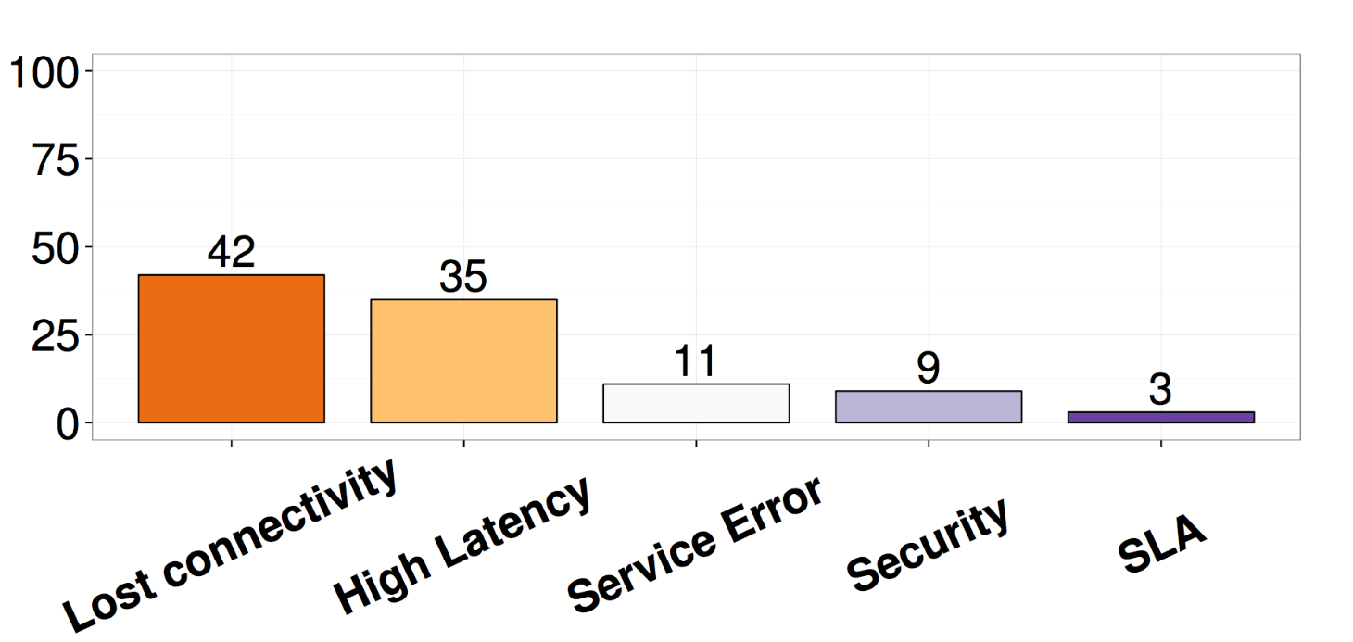


Why Bother?
Middleboxes and NFs are common source of severe network errors
42% connectivity bugs
9% security bugs
Rest latency and service issues
Potharaju R, Jain N. Demystifying the dark side of the middle: a field study of middlebox failures in datacenters. In Proceedings of the 2013 IMC 2013 Oct 23 (pp. 9-22). ACM.

Slide 11
But stateful network verification is hard
Source code complexity
Bro Network Intrusion
101,500 lines of C++, Python, Perl, Awk, Lex, Yacc
Snort IDS 220,000 C, …
Pfsense 476,438 locs of C,php,scripts,…
Hard to specify correctness
What is a correct IDS?
Interactions between middlebox behavior affects correctness

Slide 12
Interaction Introduces Bugs
Nat
ACL FW
B
B →A
C →A
Drop packet from B

Slide 13
Lesson one in Automatic Verification
[Automatically] proving stronger safety properties is easier in many cases

Slide 14
Abstract Interpretation
γ
α
α
Abstract
Concrete
α
Descriptors of
sets of stores
Sets of stores

Slide 15
Odd/Even Abstract Interpretation
All concrete states
{-2, 1, 5}
?
{x: x  Even}
{0,2}
γ
E
O
{0}
{2}
∅

α

Slide 16
Odd/Even Abstract Interpretation
All concrete states
γ
α
{-2, 1, 5}
?
{x: x  Even}
α
{0,2}
α
E
O
{0}
{2}
α
∅


Slide 17
Odd/Even Abstract Interpretation
γ
α
All concrete states
{-2, 1, 5}
?
{x: x  Even}
α
{0,2}
E
O
{0}
{2}
∅


Slide 18
Concrete Interpretation
f(a,b) = (16 * b + 3) * (2 * a + 1)
*
+
+
*
3
*
1
16
b
2
a

Slide 19
Abstract Interpretation
f(a,b) = (16 * b + 3) * (2 * a + 1)
O
*
O
O
+
+
E
O
E
O
*
3
*
1
E
?
E
?
16
b
2
a
f : _  _ → O

Slide 20
Cartesian Abstraction
a, 1
a, 1
a, 2
{a,b,c}, {1,2}
b, 2
α
γ
b, 1
b, 2
c, 2
c, 1
c, 2

Slide 21
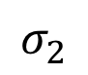
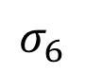
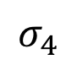
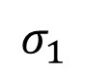
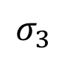
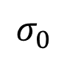
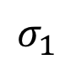
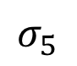
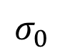
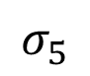
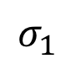
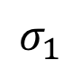
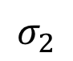
Cartesian Abstraction
$$σ_{1}$$
$$σ_{1}$$
$$σ_{1}$$
$$σ_{2}$$
$$σ_{1}$$
$$σ_{2}$$
$$σ_{2}$$
$$σ_{2}$$
$$σ_{0}$$
$$σ_{2}$$
$$σ_{0}$$
$$σ_{5}$$
$$σ_{2}$$
$$σ_{5}$$
$$σ_{3}$$
$$σ_{4}$$
$$σ_{3}$$
$$σ_{4}$$
$$σ_{1}$$
$$σ_{6}$$
$$σ_{6}$$
$$σ_{5}$$
$$σ_{0}$$
$$σ_{1}$$
$$σ_{1}$$

Slide 22
Lesson two in Automatic Verification
Rewriting the program can simplify verification process

Slide 23
How can we abstract network programs?

Slide 24
Our contribution
Abstracting middleboxes as finite state machines (FSM)
Abstracting the order of packet processing
Allowing the middleboxes to nondeterministically revert to their initial state
No need to analyze the code
Decidability [TACAS’16]
Polynomial complexity for non-temporal safety properties
[TACAS’16] Y. Velner, K. Alpernas, A. Panda, A. Rabinovich, M. Sagiv, S. Shenker, S. Shoham:
Some Complexity Results for Stateful Network Verification

Slide 25
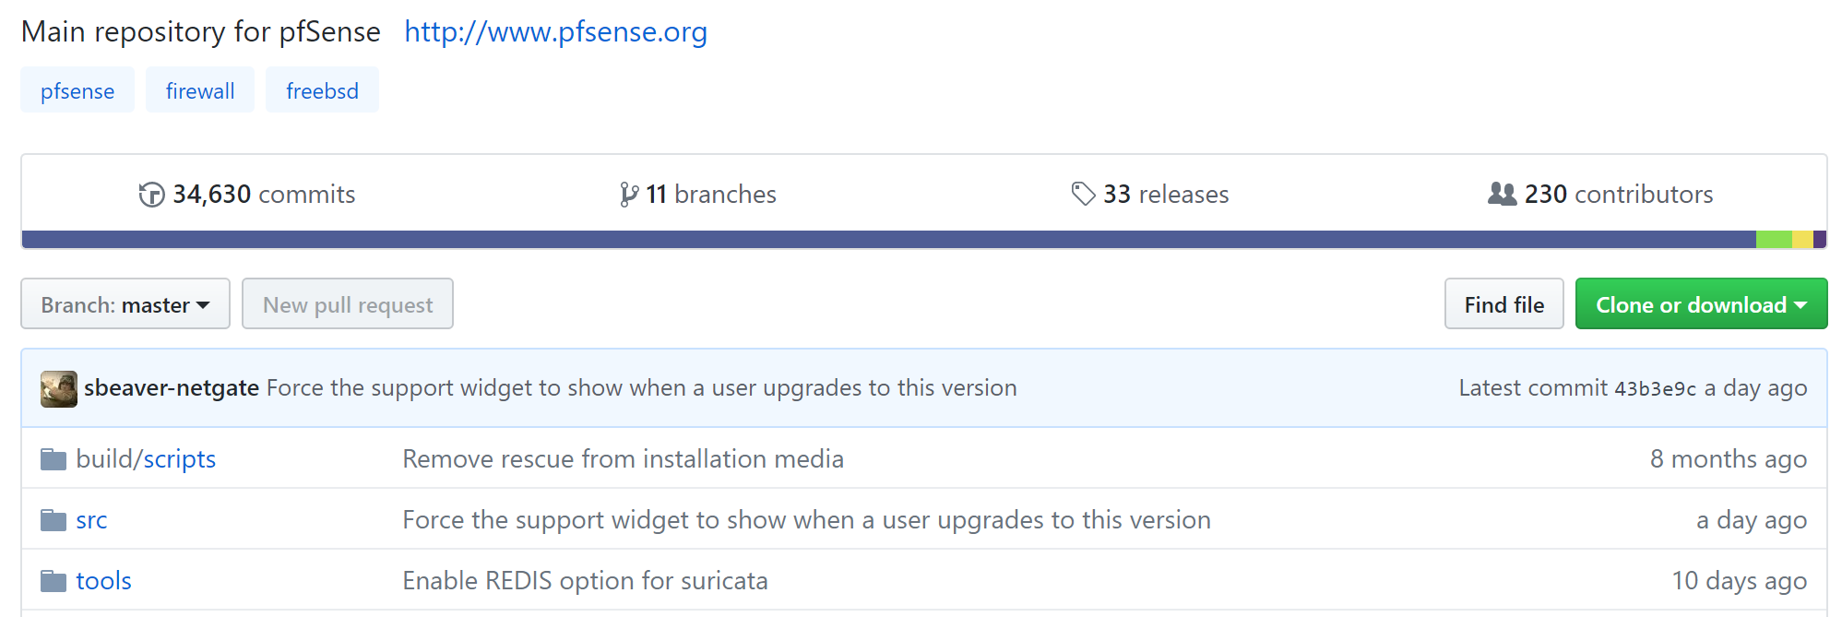
Our Hypothesis – For Safety, Middlebox≈FSM

Slide 26
pfSense/iptable Commercial Firewalls
Firewall rule components (iptables, pfSense)
Source IP
Destination IP
Source port
Input interface
Output interface
Connection established
Related flow
Disposition (accept, drop, reject)
Constants: depend only on packet
State: based on connections
Action: is packet forwarded or not?

Slide 27
pfSense/iptable: Finite State Space
State expressible as FSM:
Connection established
Related flow
Networks have limited number of flows
Finite set of hosts
Combine all of this to express as FSM
Rx Packet in flow
Not Connected
Connected
Rx Packet in related flow
Not Related
Related

Slide 28
Other Middleboxes
Can model other middleboxes similarly when verifying isolation
Example NATs, Load Balancers, Caches, Web Accelerators, etc.
Why?
Only care about decision to forward or drop packets
Can abstract out more complex state (e.g., port assigned by NAT, etc.)
Need to only consider worst-case behavior, hazarding is sufficient

Slide 29
Simplified FSM - Firewall
a
a is trusted
a→s | a→s
s→a | s→a
b→s
a→s | a→s
s→a | s→a
b→s | b→s
s→b | s→b
a
a
a→s
b→s
s→a | s→a
s→b | s→b
s

b→s | b→s
s→b | s→b
a→s
a,b
s→b | s→b
s→a | s→a
b
b
Notes:
The Input/Output behaviour of the transducer is the forwarding behaviour

Slide 30
Simplified FSM - Firewall
a
a is trusted
a→s | a→s
s→a | s→a
b→s
a→s | a→s
s→a | s→a
b→s | b→s
s→b | s→b
a
What happens for k hosts?
a
a→s
b→s
s→a | s→a
s→b | s→b
s

b→s | b→s
s→b | s→b
a→s
a,b
s→b | s→b
s→a | s→a
b
b
Notes:
The Input/Output behaviour of the transducer is the forwarding behaviour

Slide 31
Simplified FSM - Firewall
a
a is trusted
a
a
a,b
b
s

b
b,c
a,b,c
c
c
c,a
Notes:
The Input/Output behaviour of the transducer is the forwarding behaviour

Slide 32
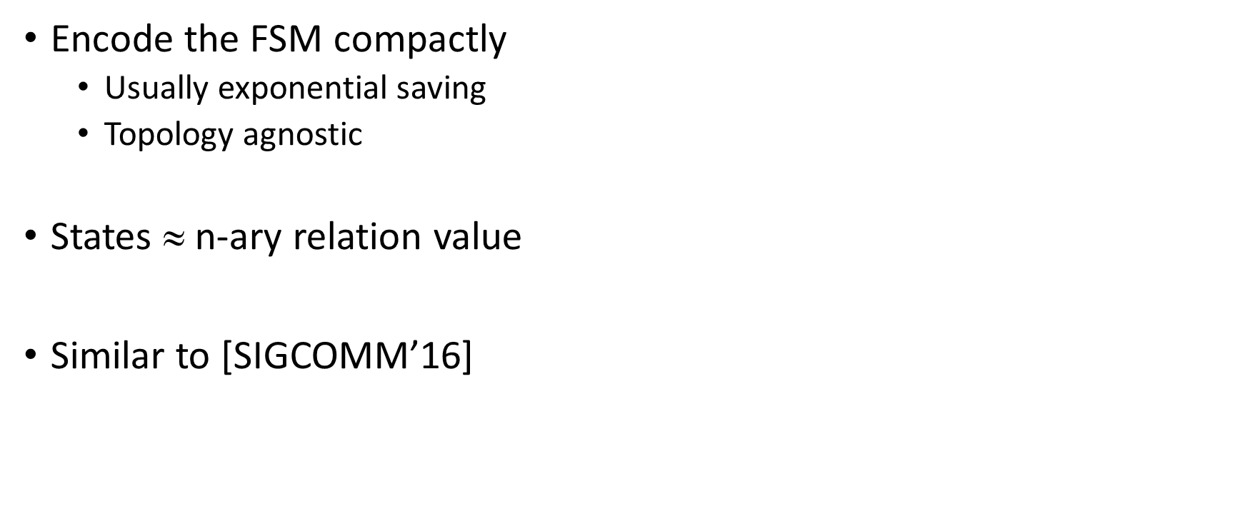
PL to the Rescue
(src, dst, type)
hole_punching_firewall =
port_1 ? src,dst,tpe =>
src in trusted =>
port_0 ! src,dst,tpe
|
port_0 ? src,dst,tpe =>
true =>
trusted(dst) := true;
port_1 ! src,dst,tpe
|
default => drop
Encode the FSM compactly
Usually exponential saving
Topology agnostic
States $$ n-ary relation value
Similar to [SIGCOMM’16]
[SIGCOMM’16] A. Sivaraman, A. Cheung, M. Budiu, C. Kim, M. Alizadeh, H. Balakrishnan, G. Varghese, N. McKeown, S. Licking: Packet Transactions: High-Level Programming for Line-Rate

Slide 33
Interaction Between Middlebox Executions
A/A
B/B
B/B
A/B
B
B/A
A/A
1
0
1
0
A/B
A/B

Slide 34
Interaction Between Middlebox Executions
A/A
B/B
B/B
A/B
B/A
A/A
1
0
1
0
A/B
A/B
A

Slide 35
Interaction Between Middleboxe Executions
A/A
B/B
B/B
A/B
A
B/A
A/A
1
0
1
0
A/B
A/B

Slide 36
Undecidability [TACAS’16]
Checking safety of fixed networks with FSMs is undecidable
Intuition:
Network links are ordered channels: point-to-point packets delivered in order
Can encode Turing machine’s tape in ordered channel

Slide 37
Network Abstractions

Slide 38
Unordered Channels Abstraction
Forgets the order of packet arrival

Slide 39
Unordered Channels Abstraction
Forgets the order of packet arrival
Middlebox

Slide 40
Unordered Channels Abstraction
Forgets the order of packet arrival
Middlebox

Slide 41
Unordered Channels Abstraction
Forgets the order of packet arrival
If isolation is identified ➔ It must hold
Potential false alarms
Middlebox

Slide 42
Unordered Channels Abstraction
Forgets the order of packet arrival
If isolation is identified ➔ It must hold
Potential false alarms
Middlebox
Middlebox

Slide 43
Unordered Channels Abstraction
Forgets the order of packet arrival
If isolation is identified ➔ It must hold
Potential false alarms
Middlebox
Middlebox

Slide 44
Unordered Channels Abstraction
Forgets the order of packet arrival
If isolation is identified ➔ It must hold
Potential false alarms
Middlebox
Middlebox

Slide 45
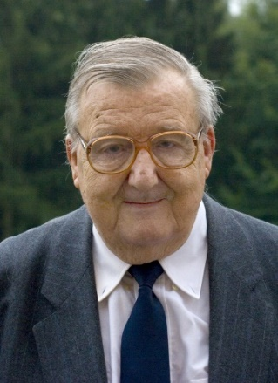
Unordered Channels Abstraction
Forgets the order of packet arrival
If isolation is identified ➔ It must hold
Potential false alarms
Safety verification is decidable
Reduction to Petri Net coverability
Middlebox
Middlebox
Carl Adam Petri

Slide 46
Unordered Channels Abstraction
Forgets the order of packet arrival
If isolation is identified ➔ It must hold
Potential false alarms
Safety verification is decidable
Reduction to Petri Net coverability
EXPSPACE complexity
Middlebox
Middlebox
Carl Adam Petri

Slide 47
Middlebox State Abstractions

Slide 48

Challenge
Middlebox state space exponential in number of hosts
Solution: apply Cartesian abstraction
Ignore correlations between internal relations
☹ Leads to severe loss of precision

Slide 49
Correlated bits example
A = {} B = {}
(src, dst, type)
corrBits = // src ∈ {1, 2}
port ? src,dst,tpe =>
A(src) := true; B(src) := true; src in A ? port_src_in_A ! src,dst,tpe; src in B ? port_src_in_B ! src,dst,tpe;
(1,_,_)

Slide 50
Correlated bits example
A = {} B = {}
A = {1} B = {1}
corrBits = // src ∈ {1, 2}
port ? src,dst,tpe =>
A(src) := true; B(src) := true; src in A ? port_src_in_A ! src,dst,tpe; src in B ? port_src_in_B ! src,dst,tpe;
(2,_,_)
(1,_,_)
(1,_,_)

Slide 51
Correlated bits example
A = {} B = {}
A = {1} B = {1}
A = {1, 2} B = {1, 2}
corrBits = // src ∈ {1, 2}
port ? src,dst,tpe =>
A(src) := true; B(src) := true; src in A ? port_src_in_A ! src,dst,tpe; src in B ? port_src_in_B ! src,dst,tpe;
(2,_,_)
(2,_,_)

Slide 52
After Cartesian abstraction
A = {1, 2}
B = {1, 2}
Also represents A = 1 B = 2
corrBits = // src ∈ {1, 2}
port ? src,dst,tpe =>
A(src) := true; B(src) := true; src in A ? port_src_in_A ! src,dst,tpe; src in B ? port_src_in_B ! src,dst,tpe;

Slide 53

Packet State
Alternative (isomorphic) state representation
But more precise for Cartesian Abstraction
Depends on AMDL

Slide 54
Packet state example
(src, dst, type)  {queries which hold}
(1,_,_)  {} (2,_,_)  {}
corrBits = // src ∈ {1, 2}
port ? src,dst,tpe =>
A(src) := true; B(src) := true; src_a: src in A ? port_src_in_A ! src,dst,tpe; src_b: src in B ? port_src_in_B ! src,dst,tpe;
(1,_,_)

Slide 55
Packet state example
(1,_,_)  {} (2,_,_)  {}
(1,_,_)  {srcA, srcB} (2,_,_)  {}
corrBits = // src ∈ {1, 2}
port ? src,dst,tpe =>
A(src) := true; B(src) := true; src_a: src in A ? port_src_in_A ! src,dst,tpe; src_b: src in B ? port_src_in_B ! src,dst,tpe;
(2,_,_)

Slide 56
Packet state example
(1,_,_)  {} (2,_,_)  {}
(1,_,_)  {srcA, srcB} (2,_,_)  {}
(1,_,_)  {srcA, srcB} (2,_,_)  {srcA, srcB}
corrBits = // src ∈ {1, 2}
port ? src,dst,tpe =>
A(src) := true; B(src) := true; src_a: src in A ? port_src_in_A ! src,dst,tpe; src_b: src in B ? port_src_in_B ! src,dst,tpe;
(2,_,_)
(2,_,_)

Slide 57
Cartesian packet state example
(1,_,_)  {} {srcA, srcB}
(2,_,_)  {} {srcA, srcB}
corrBits = // src ∈ {1, 2}
port ? src,dst,tpe =>
A(src) := true; B(src) := true; src in A ? port_src_in_A ! src,dst,tpe; src in B ? port_src_in_B ! src,dst,tpe;

Slide 58
When is this precise?

Slide 59
Precise in Reverting Networks
Middleboxes can revert to their initial state
Similar to soft state in networks

Slide 60
Simplified FSM - Firewall
a
a is trusted
a
a
s

a,b
b
b
Notes:
The Input/Output behaviour of the transducer is the forwarding behaviour

Slide 61
Reverting Networks
Middleboxes can revert to their initial state
Similar to soft state in networks
Common sense: Network resets make verification harder
Simplifies the task of automatic verification
It is easier to show that an isolation is violated
The analysis is precise for isolation

Slide 62
Complexity Results
Our solution analysis algorithm is polynomial in the network topology
Number of hosts
Number of middlebox
Number of connections
However, it is exponential in the complexity of the middleboxes
Number of queries in the most complex middlebox

Slide 63
Initial Experimental Results
Network Configuration & Topology
JSON
{…}
{…}
{…}
{…}
Middlebox Model
{…}
Compiler
LogicBlox
Packet Space States
Datalog Rules
AMDL

Slide 64
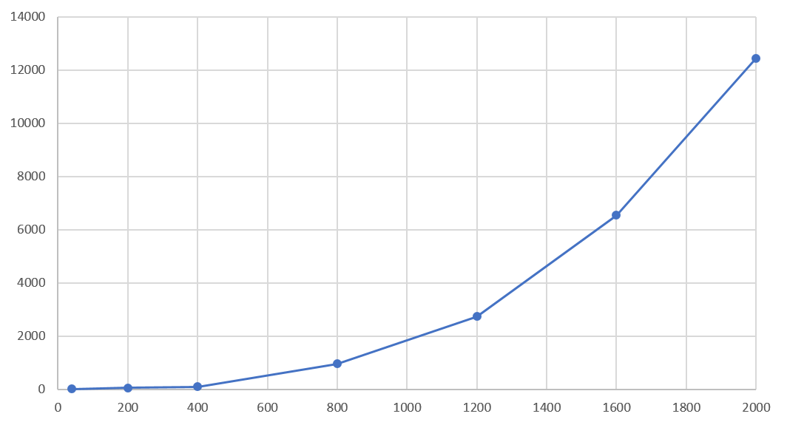
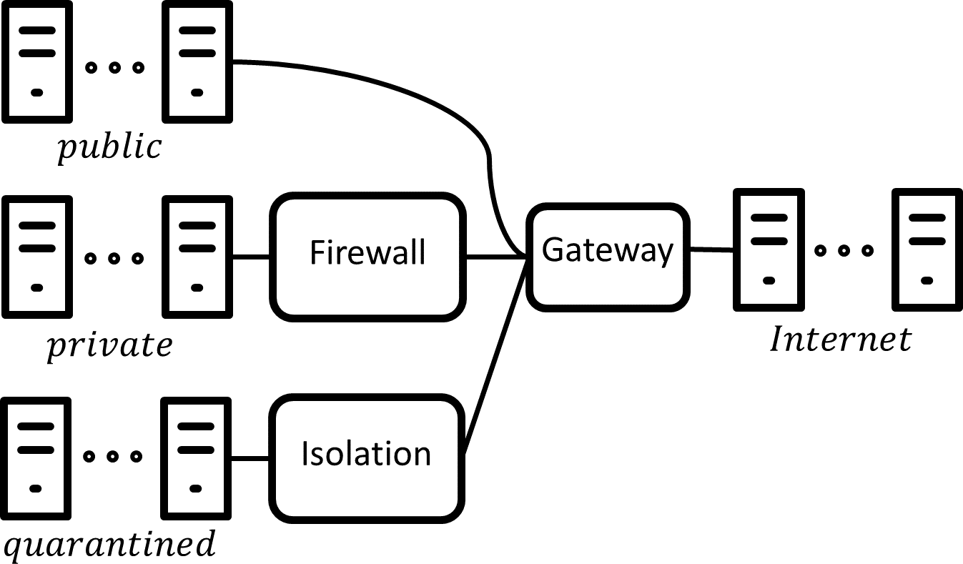
Scalability Testing - Hosts
Enterprise network with 3 subnets
Each with a different security policy
Isolation between quarantined and Internet

Slide 65
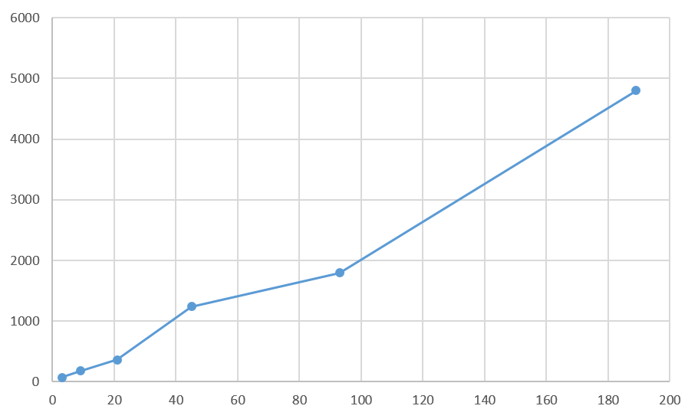
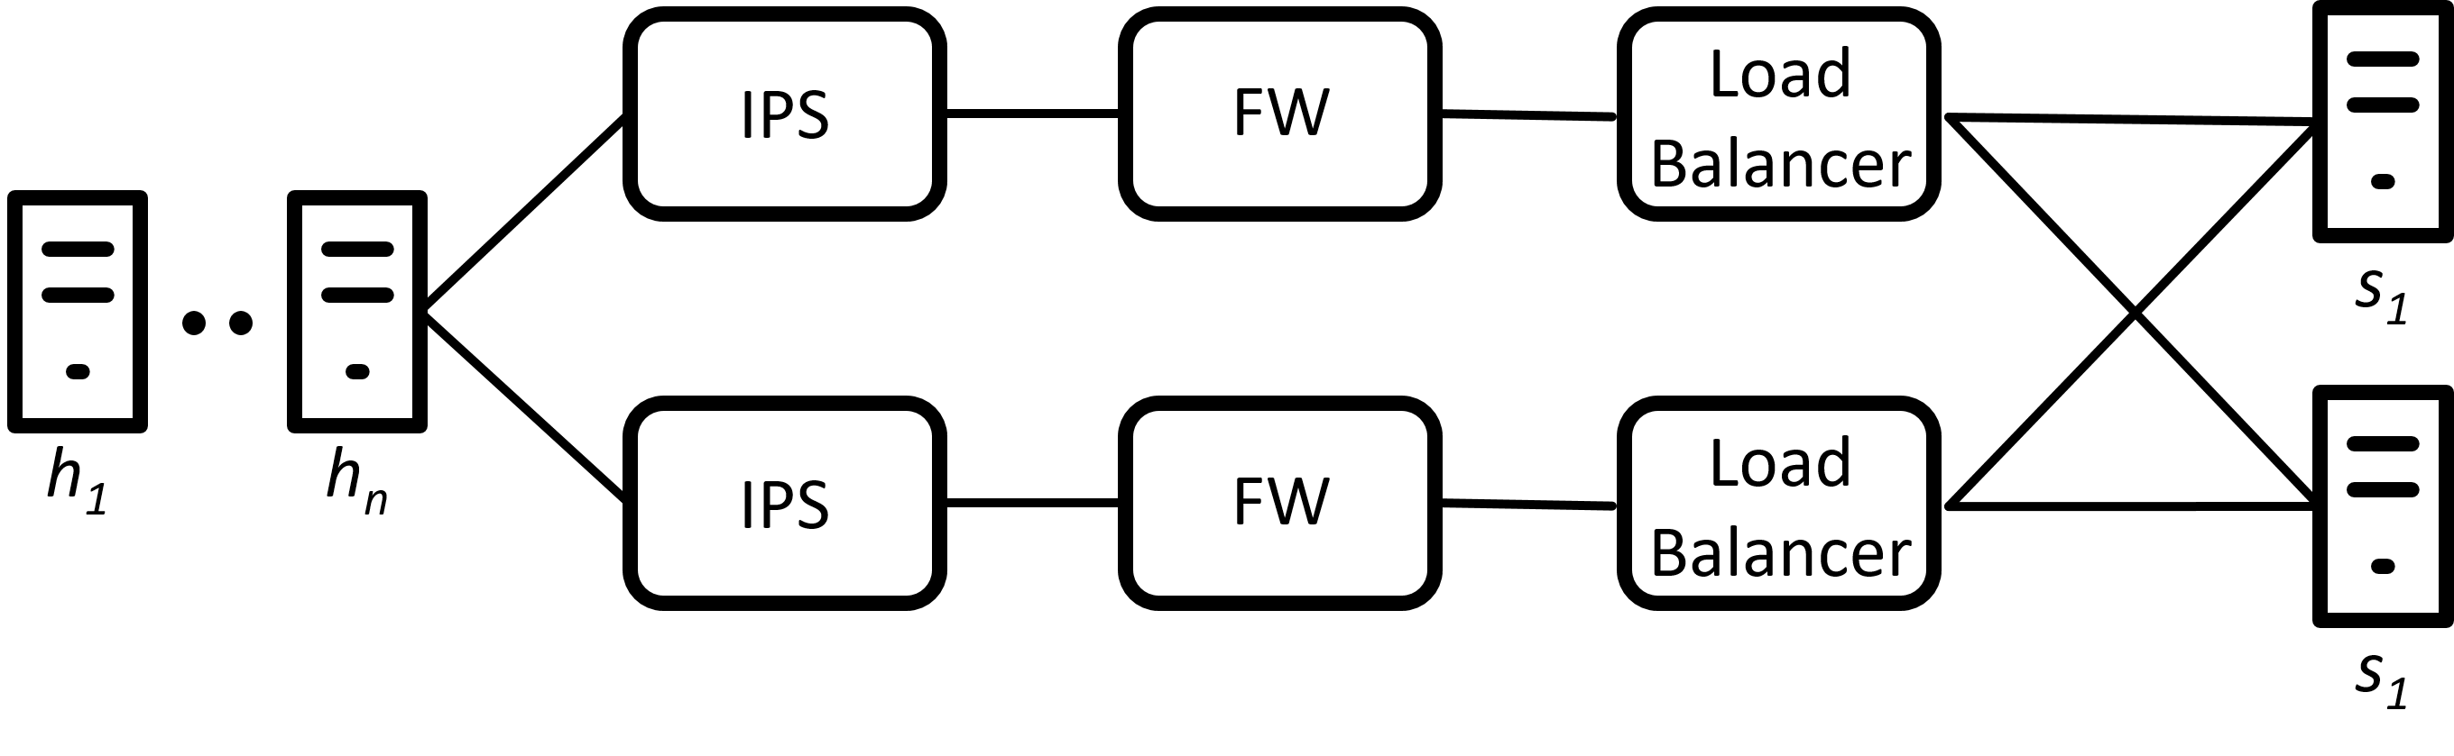
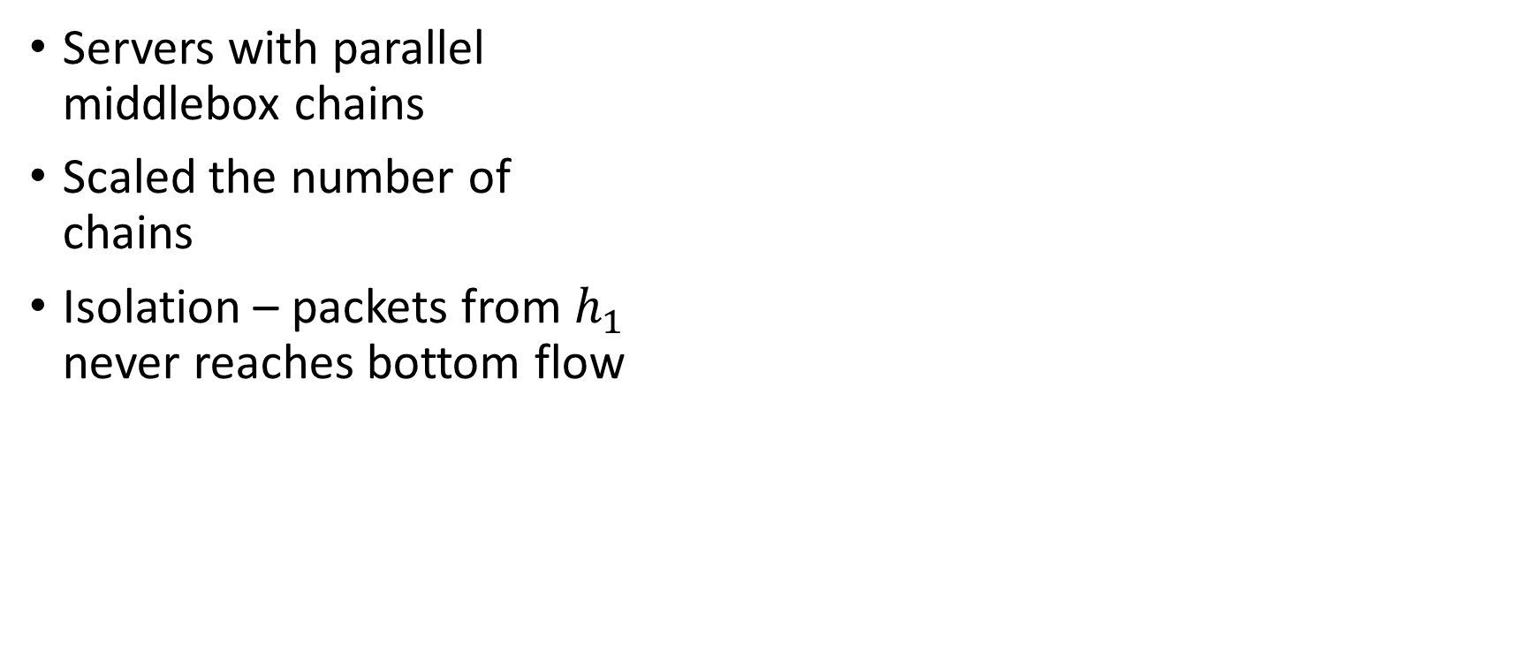
Scalability Testing - Middleboxes
Servers with parallel middlebox chains
Scaled the number of chains
Isolation – packets from $h_{1}$ never reaches bottom flow

Slide 66
Related Approaches to Stateful Verification
[NSDI’17] Reduce the safety verification to SMT
Slice the network for scalability
[SIGCOMM’17] Represent the behavior of middleboxes as global invariants
Show that the middlebox code preserve the invariants
⇓
SMT-Formula
⇓
Z3
[NSDI’17] A. Panda, O. Lahav, K.J. Argyraki, M. Sagiv, S. Shenker: Verifying Reachability in Networks with Mutable Datapaths
[SIGCOMM’17] A. Zaostrovnykh, S. Pirelli, L. Pedrosa, K. Argyraki, and G. Candea:
A Formally Verified NAT

Slide 67
Further Work
Temporal safety properties
Correlated middlebox states

Slide 68
Summary
Stateful network verification
AMDL
Cartesian abstraction
Packet effect

Slide 69
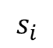
Packet State
Middleboxes are reactive systems
Read packet
Change state
Send packet(s)
Middlebox
$$s_{i}$$

Slide 70
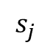
Packet State
Middleboxes are reactive systems
Read packet
Change state
Send packet(s)
Middlebox
$$s_{j}$$

Slide 71
Packet State
Middleboxes are reactive systems
Read packet
Change state
Send packet(s)
Middlebox
$$s_{i}$$

Slide 72
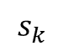
Packet State
Middleboxes are reactive systems
Read packet
Change state
Send packet(s)
Middlebox
$$s_{k}$$

Slide 73
Packet State
Middleboxes are reactive systems
Read packet
Change state
Send packet(s)

Slide 74
Packet State
Middleboxes are reactive systems
Read packet
Change state
Send packet(s)
Behaviour depends on read packet

Slide 75
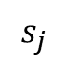
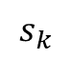
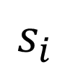
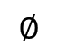
Packet State
$$s_{i}$$
Middleboxes are reactive systems
Read packet
Change state
Send packet(s)
Behaviour depends on read packet
Store state ‘Packet Effect’
For each packet, describe what the middlebox will do when it reads that packet
Input | To state | output
$$s_{j}$$
$$∅$$
$$s_{k}$$

Slide 76
Packet State Cartesian Abstraction
Forget the correlation between the effect of different packets in the same middlebox
Precision discussion in a few slides
PTIME complexity

Slide 77
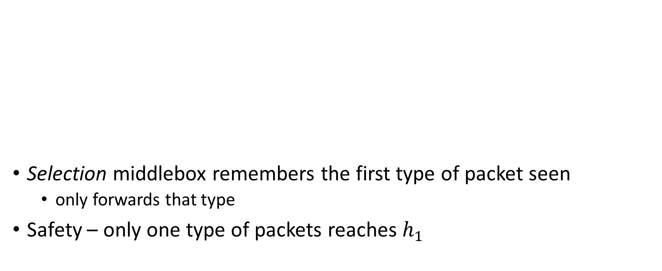
Cartesian Abstraction
Selection middlebox remembers the first type of packet seen
only forwards that type
Safety – only one type of packets reaches $h_{1}$
h₀
h₁
sel

Slide 78
Cartesian Abstraction
Selection middlebox remembers the first type of packet seen
only forwards that type
Safety – only one type of packets reaches $h_{1}$
h₀
h₁
sel

Slide 79
Cartesian Abstraction
Selection middlebox remembers the first type of packet seen
only forwards that type
Safety – only one type of packets reaches $h_{1}$
h₀
h₁
sel

Slide 80
Cartesian Abstraction
The network is safe
h₀
h₁
sel

Slide 81
False Alarm – Cartesian Abstraction
Correlations between the states is lost in Cartesian Abstraction
h₀
h₁
sel

Slide 82
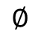
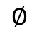
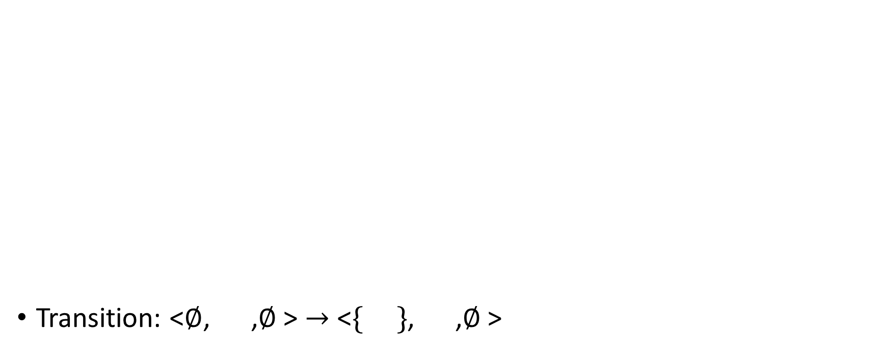
False Alarm – Cartesian Abstraction
Transition: <$∅$, ,$∅$> $→$ <$\{ \}$, ,$∅$>
h₀
h₁
sel
$$∅$$
$$∅$$

Slide 83
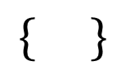
False Alarm – Cartesian Abstraction
Transition: <$∅$, ,$∅$> $→$ <$\{ \}$, ,$∅$>
h₀
h₁
sel
$$∅$$
$$∅$$
$$\{ \}$$

Slide 84
False Alarm – Cartesian Abstraction
Transition: <$∅$, ,$∅$> $→$ <$\{ \}$, ,$∅$>
h₀
h₁
sel
$$∅$$
$$∅$$
$$\{ \}$$

Slide 85
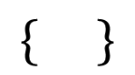
False Alarm – Cartesian Abstraction
Transition: <$∅$, ,$∅$> $→$ <$\{ \}$, ,$∅$>
h₀
h₁
sel
$$∅$$
$$∅$$
$$\{ \}$$
$$\{ \}$$

Slide 86
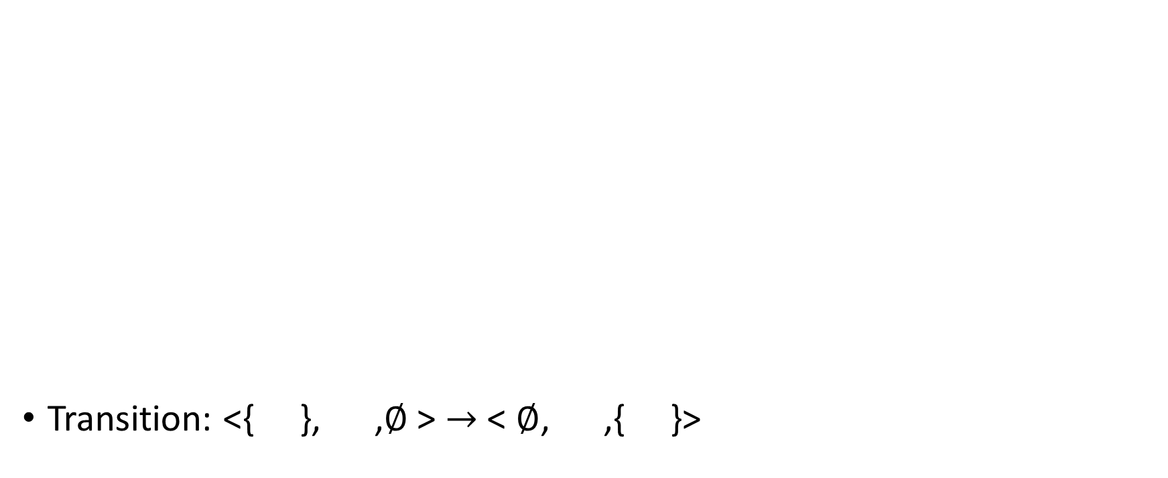
False Alarm – Cartesian Abstraction
Transition: <{ }, ,$∅$> $→$ < $∅$, ,$\text{\{ \}}$>
h₀
h₁
sel
$$∅$$
$$∅$$
$$\{ \}$$
$$\{ \}$$

Slide 87
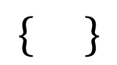
False Alarm – Cartesian Abstraction
Transition: <{ }, ,$∅$> $→$ < $∅$, ,$\text{\{ \}}$>
h₀
h₁
sel
$$∅$$
$$∅$$
$$\{ \}$$
$$\{ \}$$
$$\{ \}$$

Slide 88
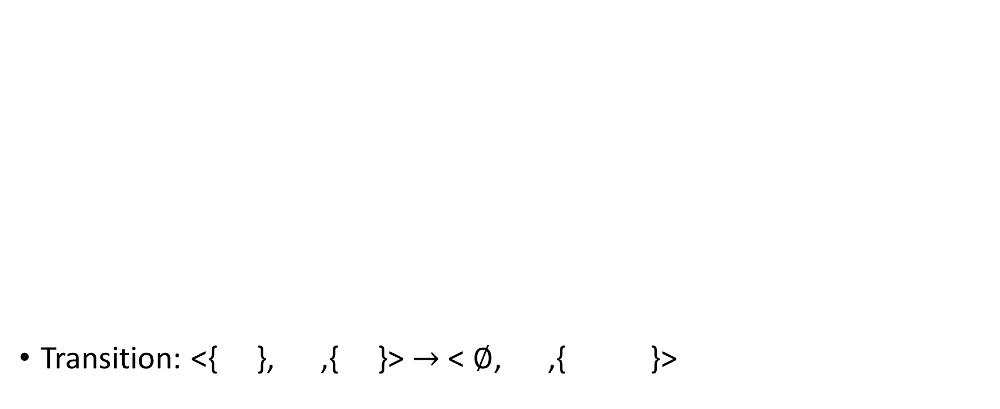
False Alarm – Cartesian Abstraction
Transition: <{ }, ,$\text{\{ \}}$> $→$ < $∅$, ,$\text{\{ } \text{\}}$>
h₀
h₁
sel
$$∅$$
$$∅$$
$$\{ \}$$
$$\{ \}$$
$$\{ \}$$

Slide 89

False Alarm – Cartesian Abstraction
Transition: <{ }, ,$\text{\{ \}}$> $→$ < $∅$, ,$\text{\{ } \text{\}}$>
h₀
h₁
sel
$$∅$$
$$∅$$
$$\{ \}$$
$$\{ \}$$
$$\{ \}$$
$$\{ \}$$

Slide 90
Cartesian Abstraction
3
3
1
2
1
2
1
2
3
Forgets the correlation between the states of different middleboxes
Channels as well

Slide 91
Cartesian Abstraction
3
C
α
β
1
2
A
B
γ
Forgets the correlation between the states of different middleboxes
Channels as well
1
A
α

Slide 92
Cartesian Abstraction
3
3
1
2
1
2
1
2
3
Forgets the correlation between the states of different middleboxes
Channels as well
Analyze each middlebox separately
w.r.t any reachable state of other middleboxes
1
1
1
2
2
3
3

Slide 93
Cartesian Abstraction
3
3
1
2
1
2
1
2
3
Forgets the correlation between the states of different middleboxes
Channels as well
Analyze each middlebox separately
w.r.t any reachable state of other middleboxes
1
1
1
2
2
3
3
1
1
3

Slide 94
Cartesian Abstraction
3
3
1
2
1
2
1
2
3
Forgets the correlation between the states of different middleboxes
Channels as well
Analyze each middlebox separately
w.r.t any reachable state of other middleboxes
EXPTIME complexity
1
1
1
2
2
3
3

Slide 95
Cartesian Abstraction
3
3
1
2
1
2
1
2
3
May produce unreachable states
1
1
1
2
2
3
3
1
3
3

Slide 96
Cartesian Abstraction
3
3
1
2
1
2
1
2
3
May produce unreachable states
1
1
1
2
2
3
3
1
3
3

Slide 97
Cartesian Abstraction
3
3
1
2
1
2
1
2
3
May produce unreachable states
No false alarms for Reverting networks
Middleboxes may revert to initial state
Soft state
1
1
1
2
2
3
3
1
3
3
Notes:
Analysis is both accurate and efficient

